Slide 1
Project (30 points)

Slide 2
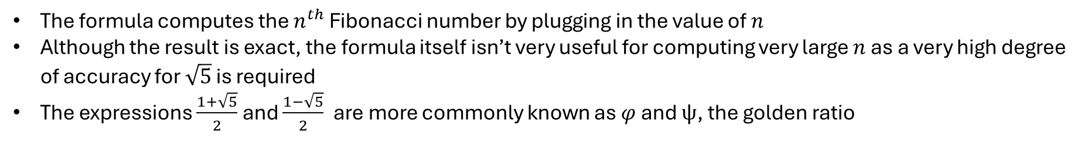

Question 1 – Research
Binet’s formula:
$$F_{n}=\frac{\left({\left(\frac{1+\sqrt{5}}{2}\right)}^{n}−{\left(\frac{1−\sqrt{5}}{2}\right)}^{n}\right)}{\sqrt{5}}$$
The formula computes the $n^{th}$ Fibonacci number by plugging in the value of $n$
Although the result is exact, the formula itself isn’t very useful for computing very large $n$ as a very high degree of accuracy for $\sqrt{5}$ is required
The expressions $\frac{1+\sqrt{5}}{2}$and $\frac{1−\sqrt{5}}{2}$are more commonly known as $φ$ and $ψ$, the golden ratio

Slide 3
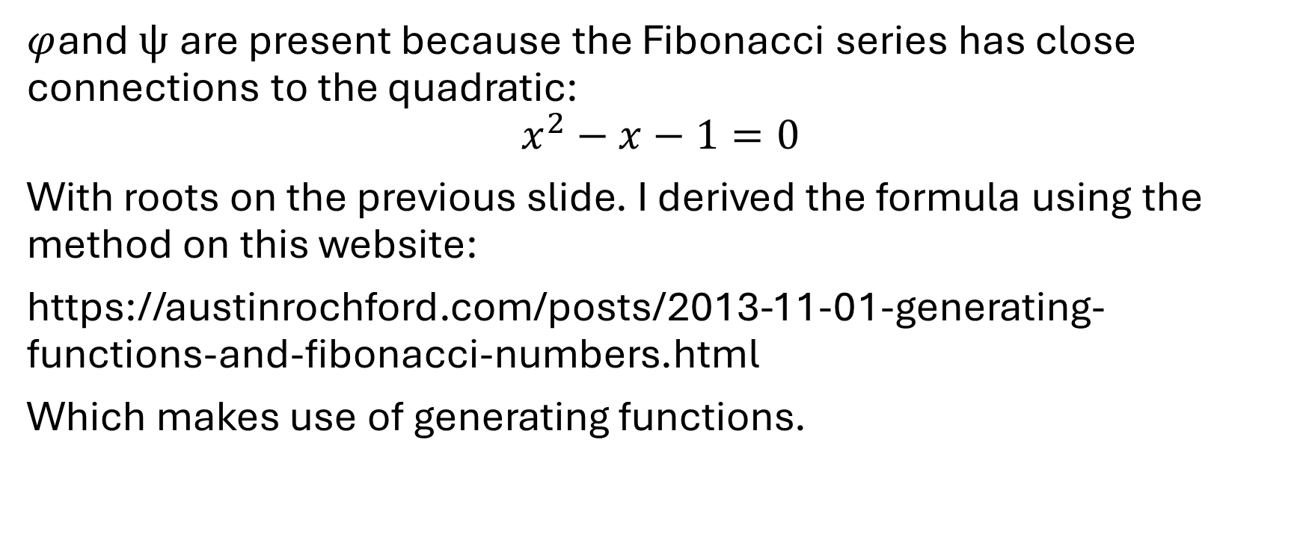
Binet’s formula derivation
$φ$and $ψ$are present because the Fibonacci series has close connections to the quadratic:
$$x^{2}−x−1=0$$
With roots on the previous slide. I derived the formula using the method on this website:
https://austinrochford.com/posts/2013-11-01-generating-functions-and-fibonacci-numbers.html
Which makes use of generating functions.

Slide 4
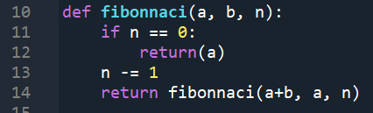
Part A: Question 2 - Recursion
Repeatedly calls the function
New values of a and b are used each time the function is run, until n reaches 0, where the function stops
Limitations: there is a maximum recursion depth so it cannot calculate F(n) with too large n.

Slide 5
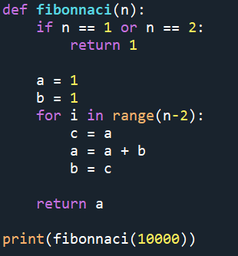
For loop
Similar to the previous method, only with a for loop
It works by reassigning the previous value of a to b, and the new value of a being the sum of the previous values of a and b.

Slide 6
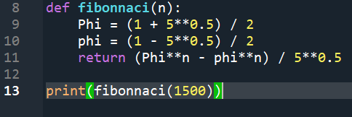
Binet’s formula
Implements Binet’s formula
I have shown how to derive this in my answer to question 1.
Limitations: It cannot calculate large n because the exponent of phi is too large

Slide 7

Question 3: Graph n vs digits in F(n)
They are directly proportional
The graph has a slope of about 0.209, meaning that the digits in $F(n)$ is rough a 5th of $n$ itself

Slide 8

Question 4 - Runtime
Time grows linearly for the function and the for loop, as it takes n steps, whereas time should be constant for Binet’s formula as it is just one calculation

Slide 9

For loop runtime
The run time is clearly not linear, but proportional to about $n^{1.9}$
This might

Slide 10

Question 5 – Lucas sequences
$$L_{n}=L_{n−1}+L_{n−2}$$
with$L_{1}=p_{1}$ and $L_{2}=p_{2}$

